Slide 1

Individual Concept Design Review
By:
Natalie Gonzalez

Slide 2





Agenda
Problem Statement
Existing Design
New Design
Requirements
Questions
Notes:
Ian Slide

Slide 3

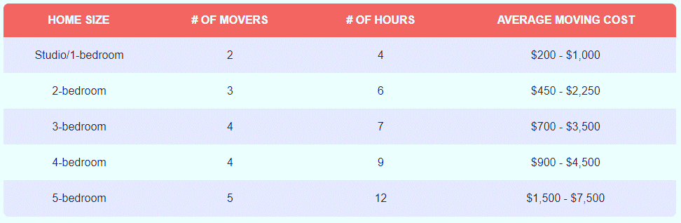
Review of the Problem Statement [1]
Transporting heavy furniture up and down the stairs is difficult and potentially dangerous
Notes:
https://www.forbes.com/home-improvement/moving-services/movers-and-packers-cost/

Slide 4

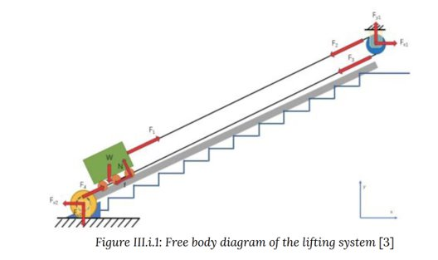
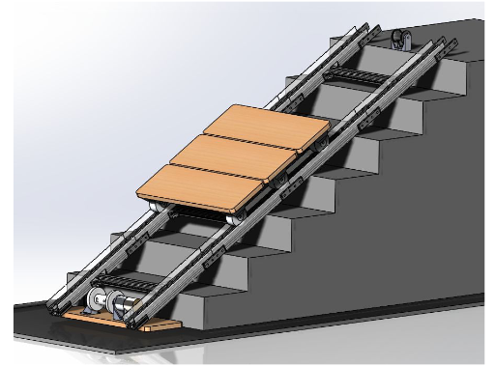
Existing Designs: Portable Stair Lift System [2]
Portable Stair Lift System
Notes:
Natalie Slide

Slide 5
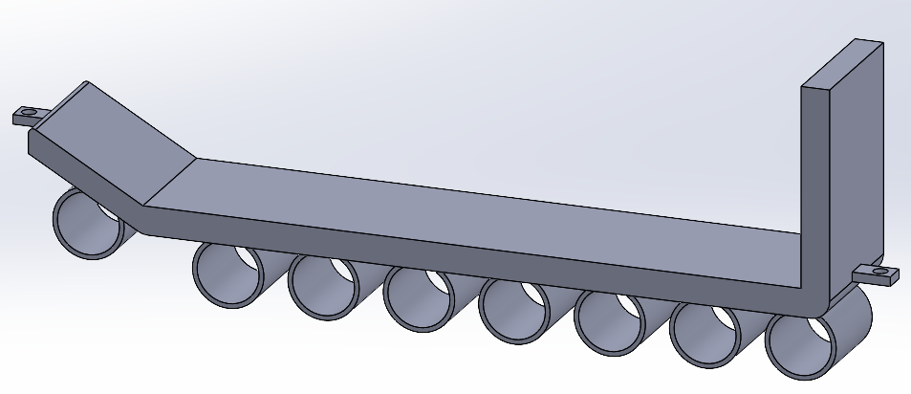

Sled
Pulley Rope Attachment
Lifted Section
Free rotating cylinders
Bracket placements
Angled Support

Slide 6
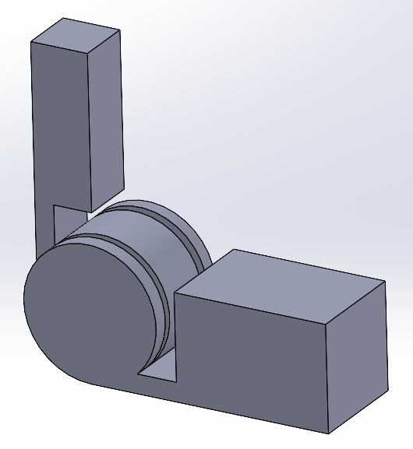
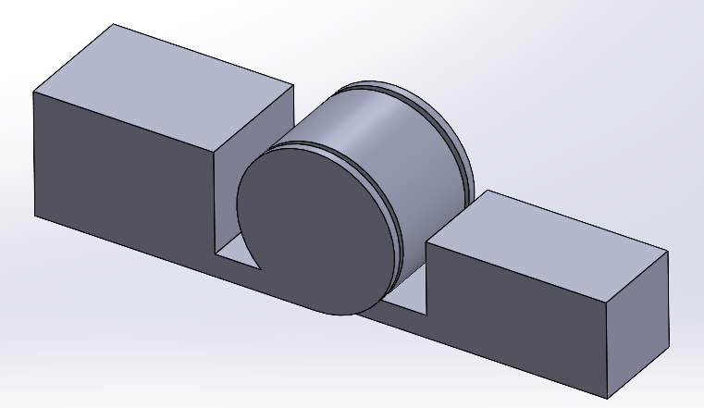
Rail and Joint designs
Small Joint
Large Joint

Slide 7
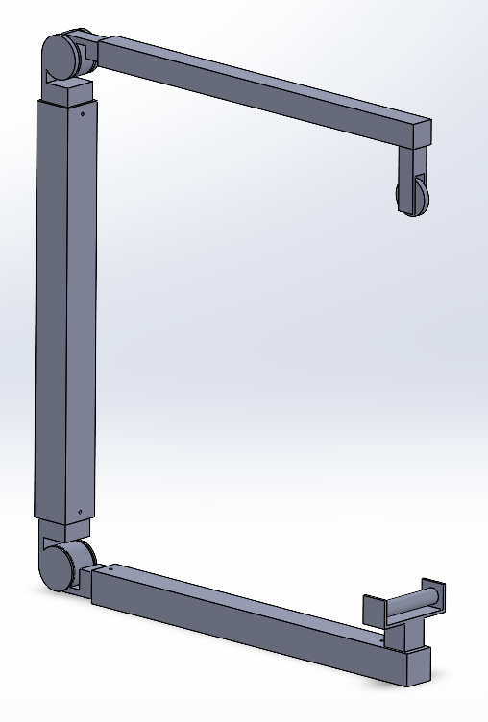
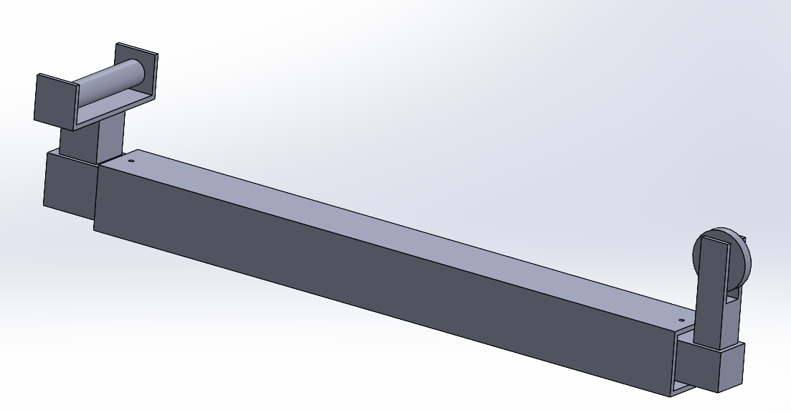
Rail and Joint designs
Locking Pin Holes
Folded Rail Configuration
Stacked Rail Configuration

Slide 8
System Flowchart
Up/ Down
Up
ON
Drive Winch Forward
Down
Drive Winch Backward
Nothing
Sensor
Nothing
Sensor
Anything
STOP
Anything

Slide 9
System Flowchart
Battery
Input Buttons:
Up/Down
Winch Motor
Sensor Input:
Anything/Nothing
Emergency Stop

Slide 10
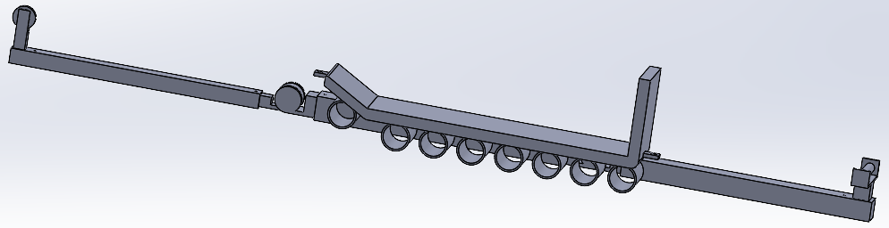
Rail and Joint designs
Pulley Rail
Small Joint
Sled
Winch Rail

Slide 11

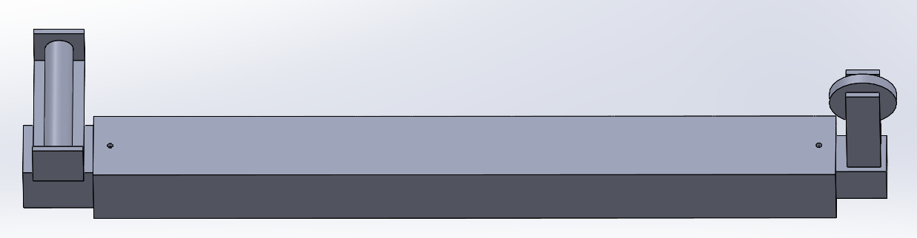
Safety
1. The system shall not destructively alter the environment.
2. The system shall not damage the furniture.
3. The system shall cause less damages than manual moving.

Slide 12
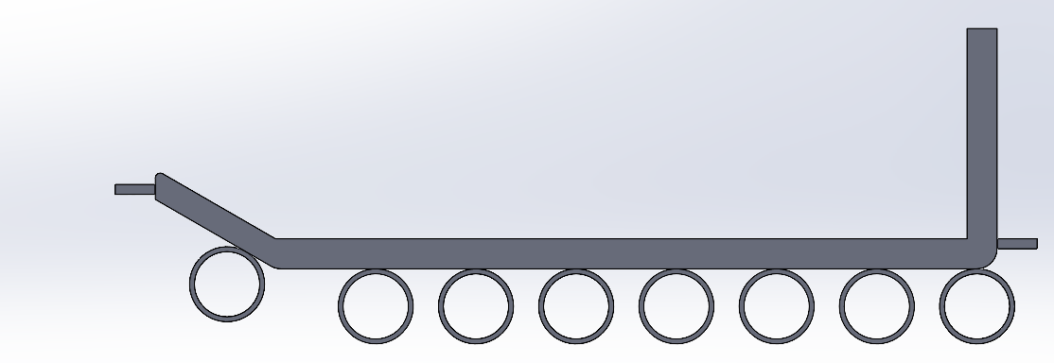
Function
4. The system shall transport furniture repeatedly up and down one floor within a residential building.
5. The system shall be reusable.
Lifted Section
Cylinder offset

Slide 13
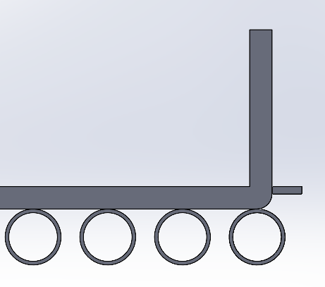
Function
6. The system shall accommodate up to a 4-seater sofa.
7. The system shall accommodate up to a 5-shelf bookshelf
Back Stop

Slide 14
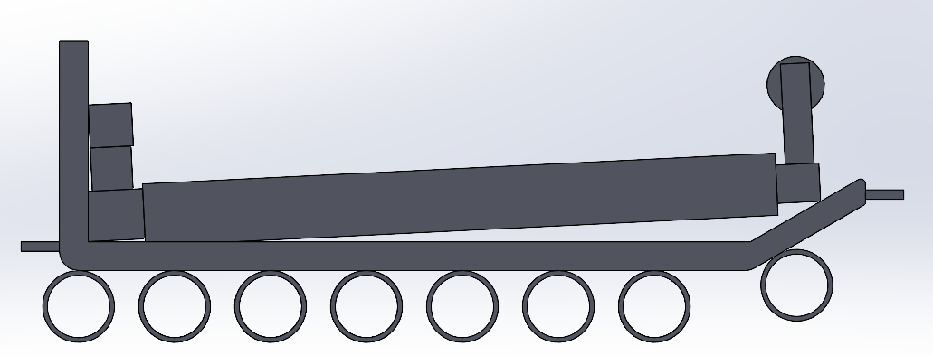
Interfacing
8. The system shall be adaptable to different building layouts.
9. The system shall be transportable in the back of a moving truck.
Stacked Rail
Sled

Slide 15
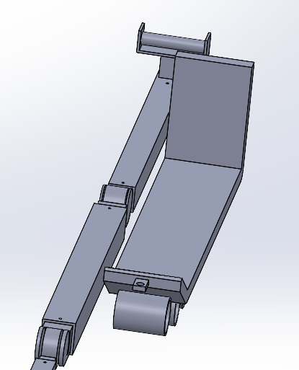
Interfacing
10. The system shall fit within a standard of the 2021 International Residential Code.
Sled
Rail

Slide 16

Questions?

Slide 17
Bibliography
A. Ogletree, “How Much Do Movers Cost In 2023?,” Forbes Home. Accessed: Sep. 24, 2023. [Online]. Available: https://www.forbes.com/home-improvement/moving-services/movers-ad-packers-cost/
M. B. ME, “Portable Stair Lift System,” PhD Thesis, WORCESTER POLYTECHNIC INSTITUTE, 2021.​

